Slide 1
Case Study Presentation
Dhruv Aditya Mittal

Slide 2
Case 1 : Hospital Stay Length Prediction
Problem Statement
Classify the Length of Stay of a Patient given different features.
Methodology
Data Processing and Analysis.
Model Selection and Training.
Results
And Validation
Problem
Practical Deployment

Slide 3
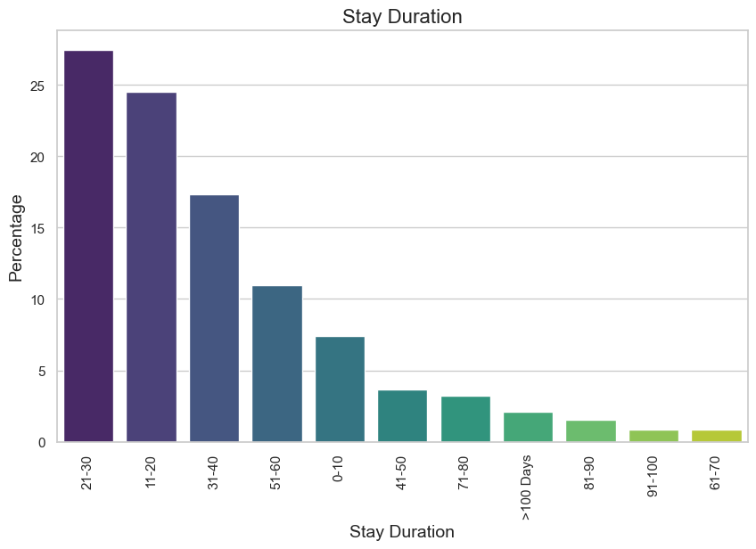
Data Processing and Analysis.
Key Data Findings.
Total Number of Features = 17.
Case Id
Hospital Code
Hospital Type Code (C)
City Code Hospital
Hospital Region Code (C)
Available Extra Rooms in Hospital
Department (C)
Ward Type (C)
Ward Facility Code (C)
Bed Grade
Patient Id
City Code Patient (C)
Type of Admission (C)
Severity of Illness (C)
Visitors with the Patient
Age (C)
Admission Deposit
C - Categorical
Length of Stay (C)
0-10
11-20
21-30
31-40
41-50
51-60
61-70
71-80
81-90
91-100
>100
>50%
Fig1. Distribution of data according to stay duration

Slide 4
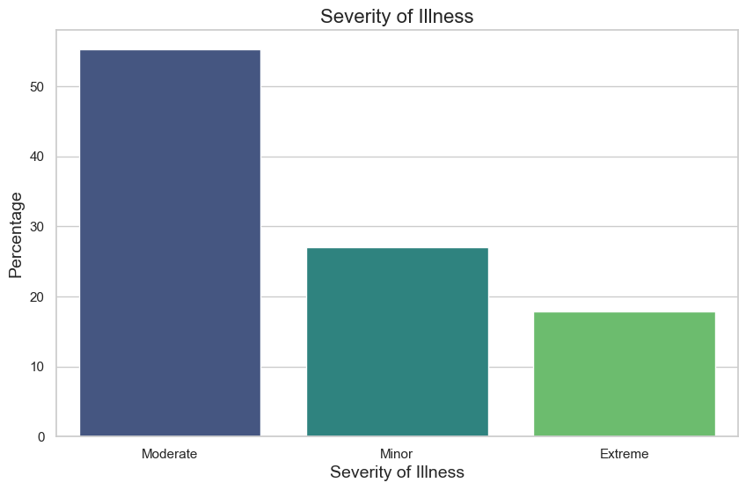
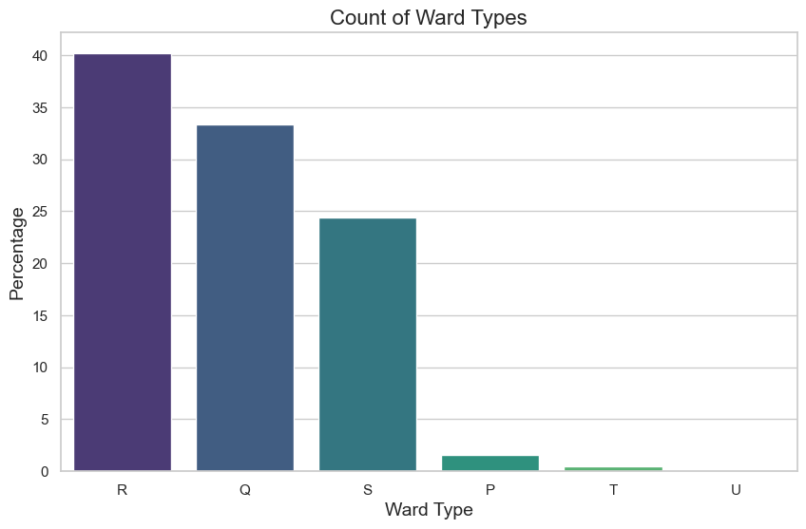
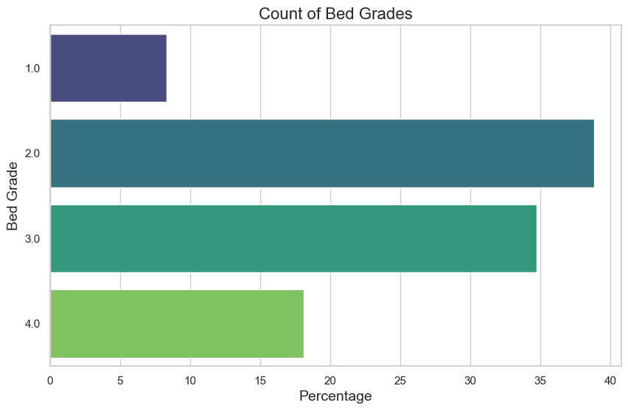
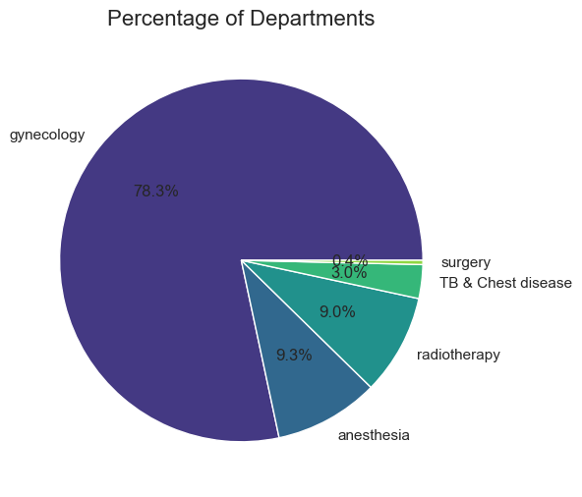
Data Processing and Analysis.
>50 % of cases have moderate illness severity (Fig 2).
R, Q, and S are the most common ward types (Fig 3).
Beds with grades 2 and 3 are the most used (Fig 4).
Most cases belong to the gynecology dept (Fig 5).
Fig2. Data Distribution according to Illness Severity
Fig3. Data Distribution according to ward type
Fig4. Data Distribution according to bed grade
Fig5. Data Distribution according to department

Slide 5
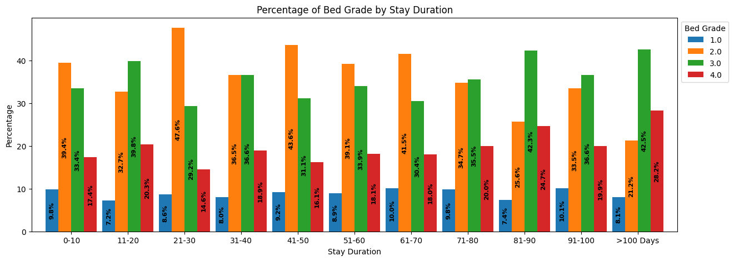
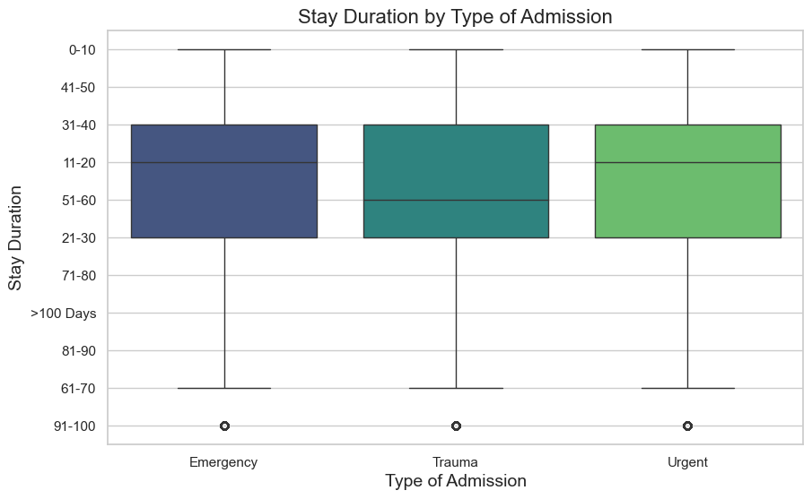
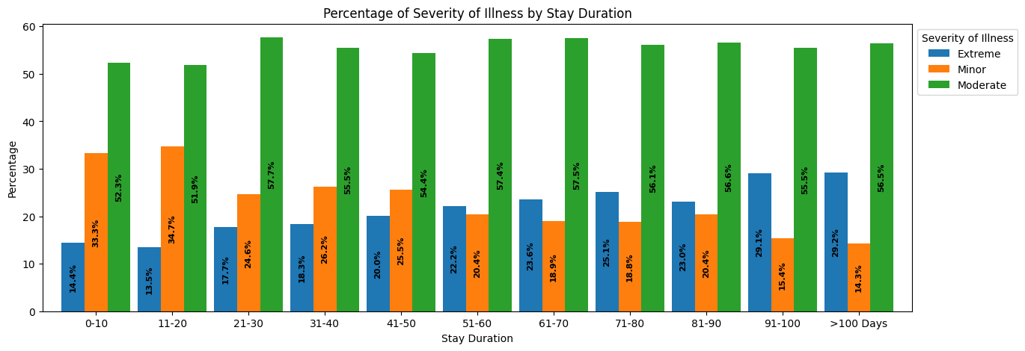
Data Processing and Analysis.
Cases of trauma tend to have a longer stay duration than other cases (Fig 6).
The percentage of beds in Grade 4 proportional to stay length
The proportion of extreme illness cases increases with the increase in stay length Fig 8).
Fig7. Distribution of stay duration wrt. to the Bed Grade
Fig6. Distribution of stay duration wrt. to Type of Admission
Fig8. Distribution of stay duration wrt. to the Illness

Slide 6
Data Processing and Analysis.
Total Rows: 318,438
Preprocessing Steps:
Columns with missing values
Bed Grade: 113
City Code Patient:4532
Categorical Columns
Replaced the null values with the most frequent entry.
Mapping the Categorical Variable to an Integer.
Exp :('Emergency': 1, 'Trauma': 2, 'Urgent': 3)

Slide 7
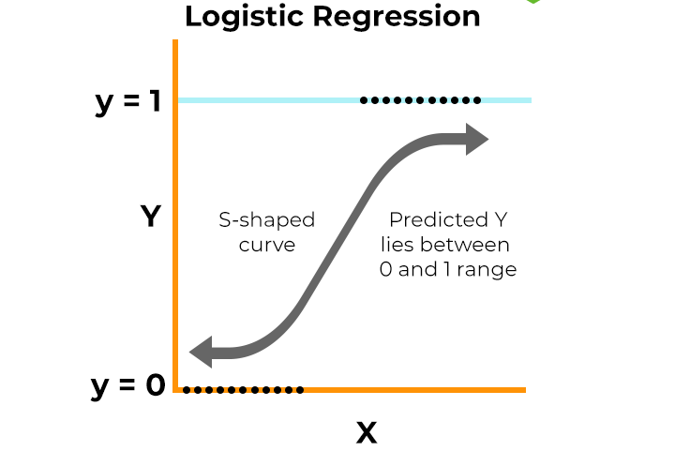
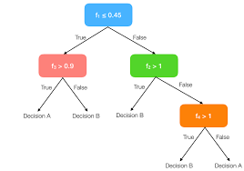
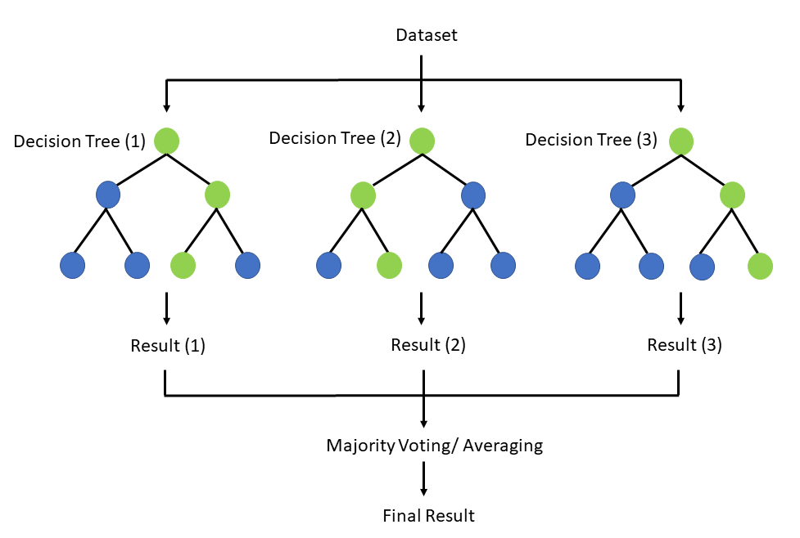
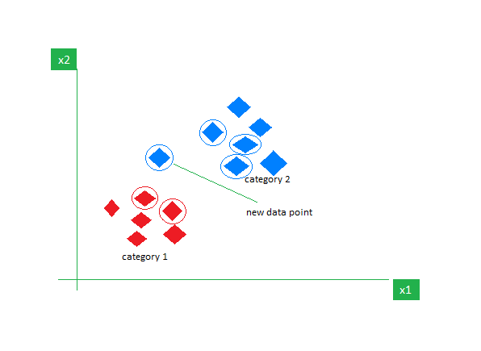
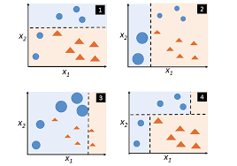
Model Selection and Training.
Selected Models
Logistic Regression (Fig 9).
Decision Tree Classifier (Fig 10).
Random Forest Classifier (Fig 11).
K Neighbours Classifier (Fig 12).
AdaBoost Classifier (Fig 13).
Training Approach
Using 5 Fold Cross Validation.
Implementation using scikit-learn libraries.
Splits
Train (80%)
Test (20%)
Fig9. Logistic Regression
Fig10. Decision Tree Classifier
Fig11. Random Forest Classifier
Fig12. K Neighbours Classifier
Fig13. Ada boost

Slide 8

Results and New Problem Statement
Model | Accuracy Scores |  | F1 Scores (average = ‘macro’)
 | Train | Test | Train | Test
Decision Tree Classifier | 0.9996 ± 0.0000 | 0.2965 ± 0.0013 | 0.9997 ± 0.0000 | 0.2163 ± 0.0019
Logistic Regression | 0.3142 ± 0.0019 | 0.3142 ± 0.0040 | 0.1050 ± 0.0027 | 0.1050 ± 0.0034
Random Forest Classifier | 0.9998 ± 0.0000 | 0.3825 ± 0.0006 | 0.9997 ± 0.0000 | 0.2625 ± 0.0010
K Neighbours Classifier | 0.4814 ± 0.0009 | 0.2673 ± 0.0013 | 0.2945 ± 0.0016 | 0.1250 ± 0.0014
AdaBoost Classifier | 0.3738 ± 0.0004 | 0.3735 ±0.0005 | 0.1877 ± 0.0012 | 0.1874 ± 0.0017
Table1. Accuracy and F1 Score of Selected Models.
Low Accuracy and Low F1 Score
What might be the issue?

Slide 9
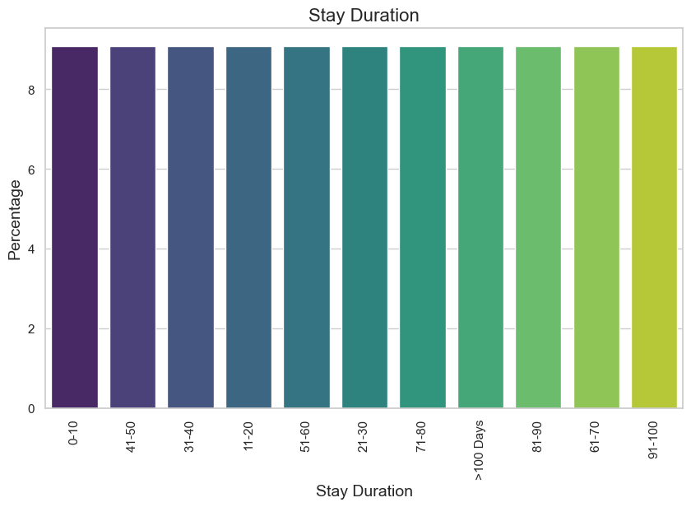
Resolving the Issue : Class Imbalance
Synthetic Minority Oversampling Technique.
(SMOTE)
Up sampling
>50%
Fig1. Distribution of data according to Stay Duration
Fig8. Distribution of data after resampling
New Methodology
Data Processing and Analysis.
Model Selection and Training.
Results
And Validation
Problem
Practical Deployment
Class Rebalance

Slide 10
Results
Model | Accuracy Scores |  | F1 Scores (average = ‘macro’)
 | Train | Test | Train | Test
Decision Tree Classifier | 0.9993 ± 0.0000 | 0.9993 ± 0.0001 | 0.9993 ± 0.0001 | 0.9993 ± 0.0000
Logistic Regression | 0.1898 ± 0.0021 | 0.1904 ± 0.0012 | 0.1460 ± 0.0007 | 0.1459 ± 0.0018
Random Forest Classifier | 0.9993 ± 0.0000 | 0.9993 ± 0.0001 | 0.9993 ± 0.0002 | 0.9993 ± 0.0000
K Neighbours Classifier | 0.5876 ± 0.0005 | 0.5877 ± 0.0017 | 0.6147 ± 0.0017 | 0.6146 ± 0.0007
AdaBoost Classifier | 0.2418 ± 0.0064 | 0.2410 ± 0.0064 | 0.1842 ± 0.0029 | 0.1849 ± 0.0045
Table2. Accuracy and F1 Score of Selected Models after Resampling
Model | Accuracy Scores |  | F1 Scores (average = ‘macro’)
 | Train | Test | Train | Test
Decision Tree Classifier | 0.9996 ± 0.0000 | 0.2965 ± 0.0013 | 0.9997 ± 0.0000 | 0.2163 ± 0.0019
Logistic Regression | 0.3142 ± 0.0019 | 0.3142 ± 0.0040 | 0.1050 ± 0.0027 | 0.1050 ± 0.0034
Random Forest Classifier | 0.999 ± 0.0000 | 0.3825 ± 0.0006 | 0.9997 ± 0.0000 | 0.2625 ± 0.0010
K Neighbours Classifier | 0.4814 ± 0.0009 | 0.2673 ± 0.0013 | 0.2945 ± 0.0016 | 0.1250 ± 0.0014
AdaBoost Classifier | 0.3738 ± 0.0004 | 0.3735 ±0.0005 | 0.1877 ± 0.0012 | 0.1874 ± 0.0017
Table1. Accuracy and F1 Score of Selected Models.

Slide 11
Conclusion
Using SMOTE technique helps tackle the issue of imbalanced dataset.
Balanced dataset helps achieve great test accuracy.

Slide 12
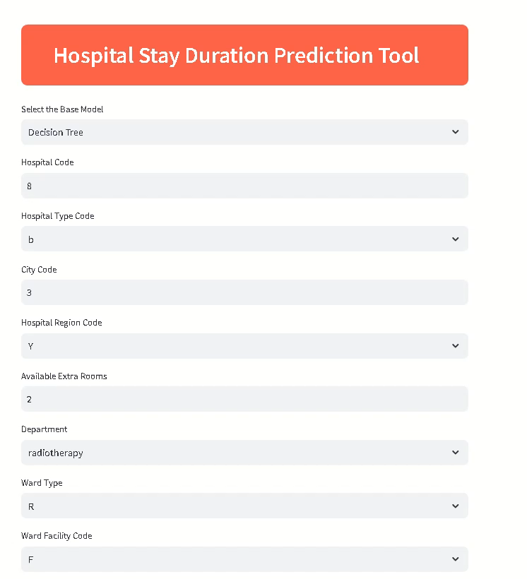
Practical Deployment
Deployed using streamlit library.
Predicts the hospital stay length given the inputs

Slide 13
Case Study 2
Predict the Quality of a question posted on Stack Overflow.

Slide 14
Problem Statement and Methodology
Problem Statement
Classify the data quality, given an unstructured text data.
Methodology
Data Processing and Analysis.
Model Selection and Training.
Results and Validation
Problem
Practical Deployment

Slide 15
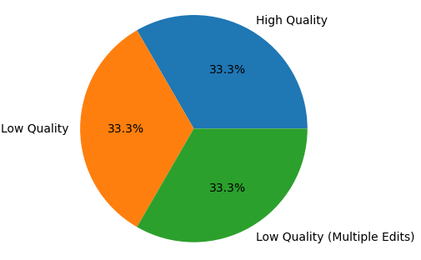
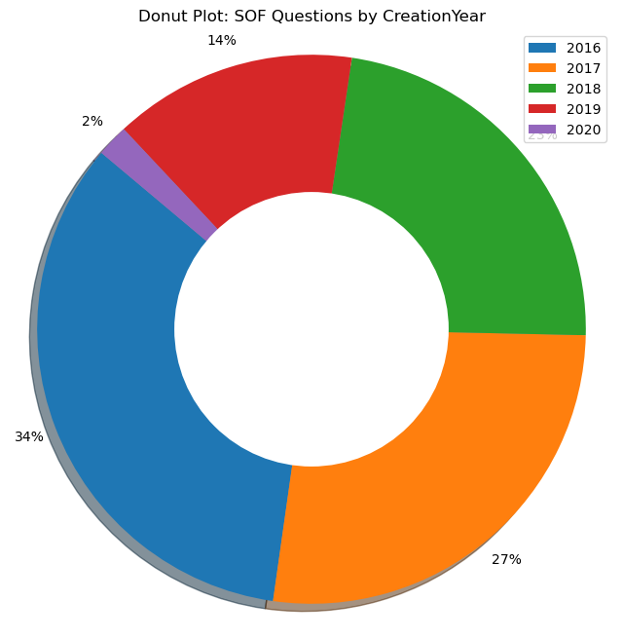
Data Processing and Analysis.
Key Data Findings.
Features:
Title
Body
Tags
Data is balanced
Most of the data is collected in 2016 - 2018
Question Quality
HQ
LQ_EDIT
LQ_CLOSE
Fig 1 Label distribution in training data
Fig 2 Training Data distribution by Year.

Slide 16

Data Processing and Analysis.
Join Title, Body and Tags
Data Cleaning,
Stop Words Removal
Tokenization
Embedding Representation
Lowercasing
Removing non-alphabetical characters

Slide 17
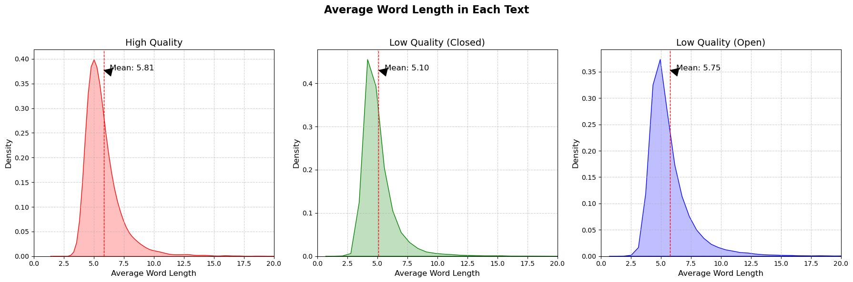
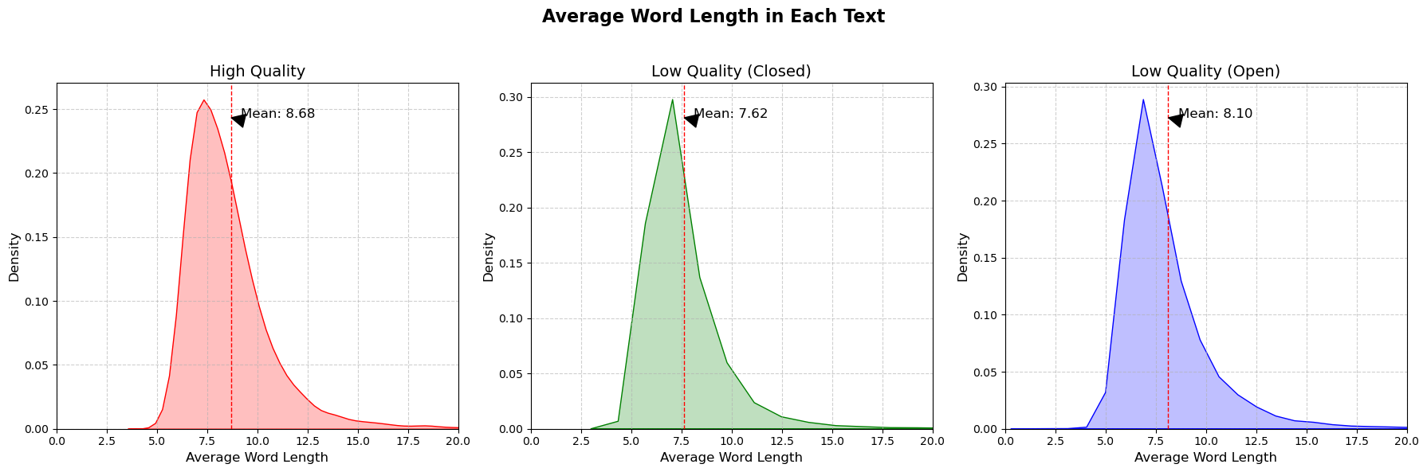
Data Processing and Analysis.
Before Removing Stop words
After Removing Stop words
Fig 3 Distribution of word length before and after removing stop words,

Slide 18
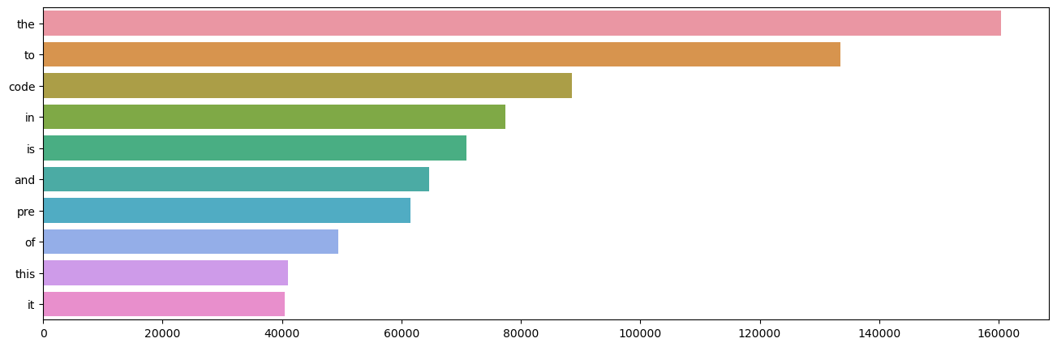
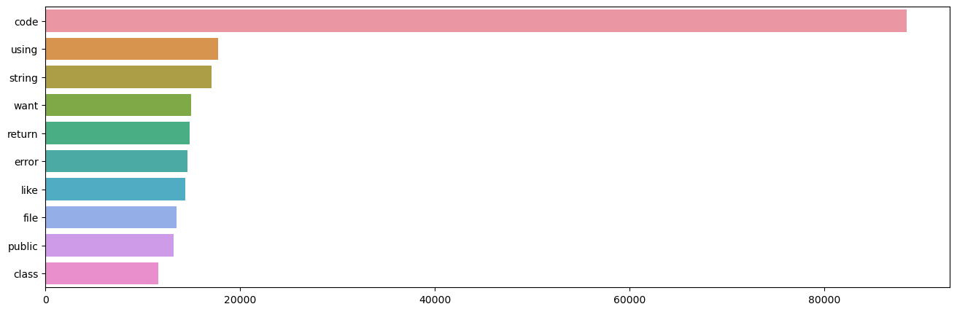
Data Processing and Analysis.
Before Removing Stop words
After Removing Stop words
Fig 4 Unigrams count before and after removing Stop words

Slide 19
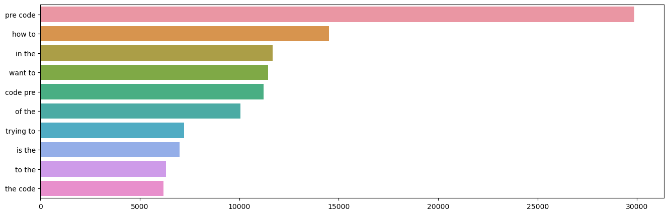
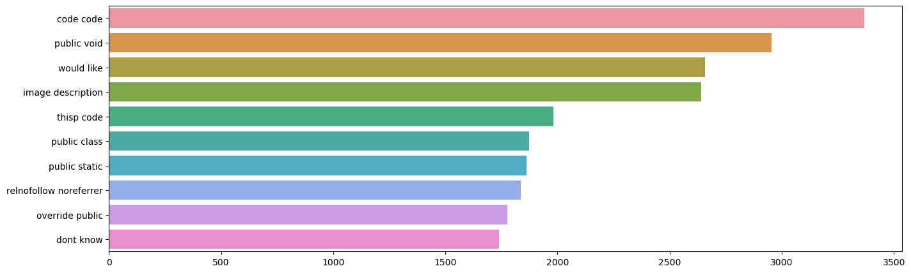
Data Processing and Analysis.
Before Removing Stop words
After Removing Stop words
Fig 5 Bigrams count before and after removing Stop words

Slide 20
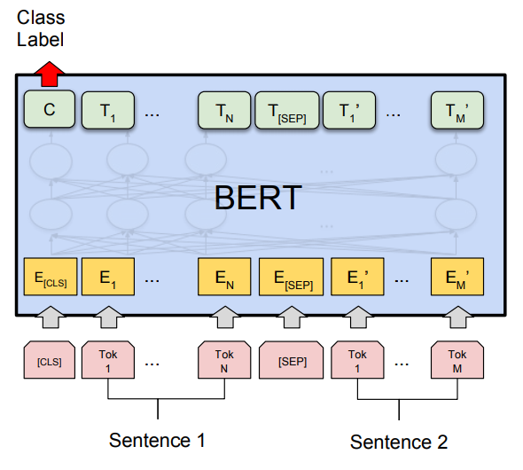
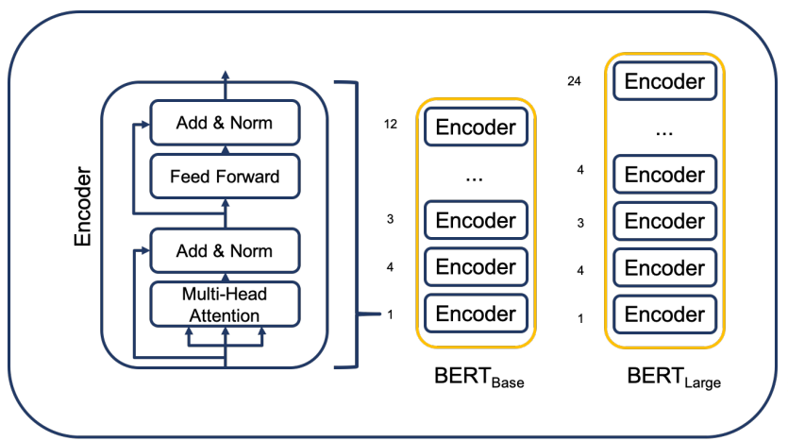
Model Selection and Training.
BERT (Bidirectional Encoder Representation)
Fig 7 Basic Foundation for BERT model
Fig 8 Training of BERT Model

Slide 21
Model Selection and Training.
M – Max Value
MAX_LEN = 300
Frozen Pretrained Bert Model
[4800]
[300,768] (last hidden layer)
[3]
LSTM
(Hidden Size = 300)
CNN
(Kernel Size 3, padding = ‘same’, filters = 32)
CNN
(Kernel Size 3, padding = ‘same’, filters = 16)
[Flatten]
M
Output
[300, 300]
[32,300]
[16,300]

Slide 22
Model Selection and Training.
Model Parameters
OPTIMIZER = ADAM
LOSS = CROSS ENTROPY
MAX LEN = 300
MAX EPOCHS = 20
EARLY STOPPING COUNT = 5
BATCH SIZE = 256
NUM OF FOLDS = 5
TOKENIZER = BERT
TRAINED ON : NVIDIA: RTX8000
Data Split
Train (80%), Val (10%), Test (10%)

Slide 23
Results
 | STOP WORD REMOVED | Accuracy |  |  | F1 Score
 |  | Train | Val | Test | Train | Val | Test
Bert- BASE | True | 0.9095 ± 0.0103 | 0.8802 ± 0.0029 | 0.8719 ± 0.0059 | 0.9091 ± 0.0104 | 0.8799 ± 0.0028 | 0.8720 ± 0.0057
 | False | 0.9518 ± 0.0220 | 0.9311 ± 0.0043 | 0.9215 ± 0.0082 | 0.9518 ± 0.0220 | 0.9300 ± 0.0042 | 0.9212 ± 0.0089
Bert- LARGE | True | 0.9124 ± 0.0127 | 0.8856 ± 0.0026 | 0.8713 ± 0.0027 | 0.9120 ± 0.0128 | 0.8851 ± 0.0030 | 0.8711 ± 0.0029
 | False | 0.9424 ± 0.0079 | 0.9303 ± 0.0013 | 0.9183 ± 0.0034 | 0.9424 ± 0.0079 | 0.9302 ± 0.0018 | 0.9182 ± 0.0034
Table 1 Accuracy and F1 Score Comparison before and after removing stop words
Using Stop words in the inputs provides better performance

Slide 24
Conclusion
Bert Base without removing stop words have the best performance.
In this case study we need stop words to have better model performance.

Slide 25

Practical Deployment
Deployed using Streamlit library.
Predicts the Question Quality given the inputs.

Slide 26


